Slide 1
Presentation on Shoot the Duck
By:
R.PrithivRaj
R.Tamizhselvan
K.Sri Kandhan

Slide 2
Abstract :-
This game takes inspiration from the 1984 Nintendo game ”Duck Hunt”.
Shoot the duck is a shooter game in which the objective is to shoot as many moving targets as possible.
The game is played from a first person perspective .
The player requires to move the mouse to aim and fire at as many ducks as possible.
The ultimate goals of the player is to get as many ducks within the specified time.
The points of total ducks escaped , shots fired and total ducks killed is displayed on the top left of the screen.

Slide 3
Problem Statement :-
To give the retro game a little twist .
Games provide an enjoyable experience to users and to even the coders .
The challenge to recreate a legendary game with improvements by us .

Slide 4
Introduction :-
This game was originally invented and published by Nintendo Entertainment System in 1984 .
This game required a NES Zapper and a CRT television to shoot the ducks which appeared on the screen .
“Shoot the Duck” doesn’t require any such mechanisms and can be controlled by our finger tips with the use of a mousepad or a mouse .
Instead of the ducks appearing one at a time from the bottom of the screen a sequence of ducks arrive from the right and exit towards the left of the screen.
The ultimate goal of the player is to get as many ducks before they escape from the left of the screen .
“Shoot the Duck” has totally revamped the scoring system and the levelling up system .
The game has separate counters for total points scored , total shots fired and number of ducks that escaped .
The speed of the ducks passing the screen gradually increases as the time passes .

Slide 5
Existing System :-
The gaming method and scoring systems are old and outdated .
This game had to played in televisions which had CRT support , hence the accessibility for users was limited .
This game required separate device such a NES Zapper which has to be bought separately at a high price .

Slide 6
Proposed System :-
The shooting accuracy has been improved a lot with simple gestures to play .
“Shoot the Duck” can be played on personal computers , desktops etc ….
This game does not require any other extra devices for shooting such as NES Zapper and can be controlled with a mousepad or a mouse .

Slide 7
Hardware Requirement :-
Pentium V processor or higher
1 Gb Ram (or above)
40 Gb HARDDISK
Mouse/Keyboard
Software Requirement :-
OS – Windows 7 or higher
Jre Environment 1.5 or higher
JDK
Notepad/Netbeans

Slide 8
Lobby – User decides whether to start the game or not :-
The game’s logo is displayed in this screen .
The user has various options as to start the game or exit the game .
User is given information on how to shoot the duck to score points .
User may also exit the game by clicking ESC or starting the game use the left mouse button .

Slide 9
Gameplay – how the game can be played :-
The ducks appear from the right of the screen and swims towards the left end of the screen .
Each duck shot gets awarded with 30 points .
The mouse can be moved to take shots at the ducks .
Each shot taken is calculated under ‘shoots’ .
The number of runaway ducks is calculated .

Slide 10
Decisions – The game is at its end :-
The user has exhausted all his lives and the game has ended .
The total number of kills, shots taken and score can be viewed here.
A game over pop up has appeared on the screen .
User can either click on spacebar to restart the game or ESC to exit it .

Slide 11
Coding :-
private int runawayDucks;
*How many ducks leave the screen alive*
private int killedDucks;
*How many ducks the player killed*
private int score;
*For each duck killed, the player gets points*
private int shoots;
*How many times a player shoots*
private BufferedImage backgroundImg;
*Games background image*
private BufferedImage duckImg;
*Duck image*
private BufferedImage sightImg;
*Shotgun sight image*

Slide 12
Coding :-
public void RestartGame()
*Restart game- reset some variables*
If(runawayDucks>=200)
Framework.gameState=Framework.GameState.GAMEOVER;
*When 200 ducks runaway the game ends*
public abstract void
mousePressed(MouseEvent e):
*Mouse key is pressed*
Public abstract void
mouseReleased(MouseEvent e):
*Mouse key is released*
public abstract void
mouseClicked(MouseEvent e)
*when user shoots the duck components respond*

Slide 13
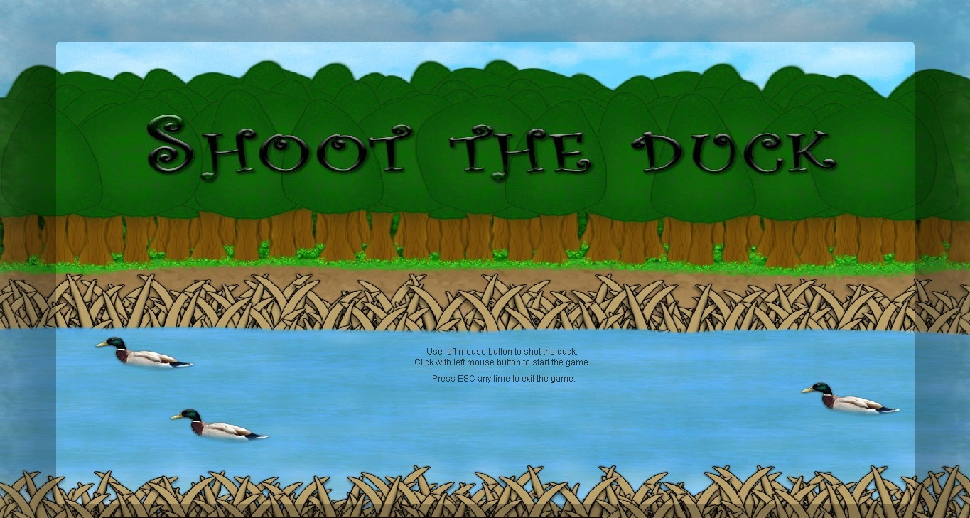
Output :-
The games logo pops up in this screen.
Instructions are shown on how to play the game .
Spacebar can be used to start the game .
ESC can be used to exit the game .

Slide 14
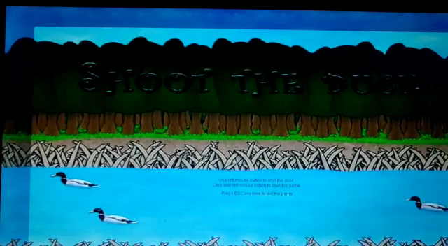
Output :-
The ducks appear from the right of the screen and swims towards the left end of the screen .
Each duck shot gets awarded with 30 points .
The mouse can be moved to take shots at the ducks .
Each shot taken is calculated under ‘shoots’ .
The number of runaway ducks is calculated .

Slide 15
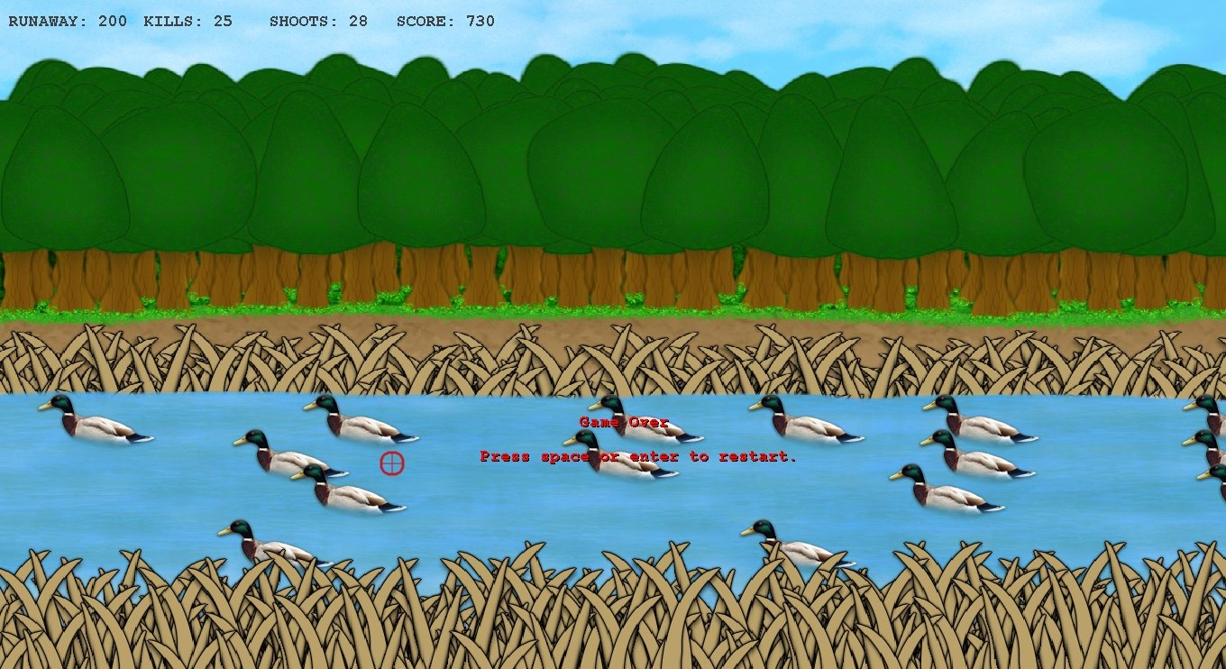
Output :-
The user has exhausted all his lives and the game has ended.
The total number of kills, shots taken and score can be viewed here.
A game over pop up has appeared on the screen .
User can either click on spacebar to restart the game or ESC to exit it .

Slide 16
Conclusion :-
The projects goals is to shoot the duck which is a real graphical UI game .
The report gives details of the games rendering methods on the implementation on the game .
The proposed algorithm is based on several screen sizes and different processing environments .
By providing the appropriate speed we enhance the users interests .

Slide 17
References :-
Wikipedia
www.StudyStuff.in

Slide 18
Future Works :-
More game stages will be provided .
Pause opition can be included into this software .
Multi user facility can be included into this software .

Slide 19


